Slide 1




Bhasha Bandhu Hackathon
Innovating for a Multilingual Judiciary
Innovating for a Multilingual Judiciary
Team Name : Data Morphers Team: Prashant, Saket, Manas, Ritik Date:21-Feb-2025
Supported by

Slide 2
MediZen – AI-Powered Mediation Awareness Platform
The Legal Awareness Gap
Mediation is a faster, cost-effective alternative to court cases, but awareness is low.
Citizens, businesses, and institutions lack access to structured mediation resources.
Language barriers make it difficult for people to understand legal processes in India.
Goal: Build a multilingual AI-powered platform that educates, assists, and connects users with mediators.
Notes:
Idea Submissions Form – Details of the form Topic
Thesis Abstract Concept Note What is the solution Build? Business use case (Less than 100 – 200 words) Judge and filter becomes easy

Slide 3
Solution
MediZen – AI-Powered Mediation Awareness Platform
AI Chatbot & Voice Assistant – Educates users about mediation in regional languages.
Legal Document Generator – Auto-fills mediation request forms based on user input.
Mediator Directory – Connects users with certified mediators online.
Gamified Learning & Interactive Case Studies – Engages users in real-world mediation scenarios.
Notes:
Idea Submissions Form – Details of the form Topic
Thesis Abstract Concept Note What is the solution Build? Business use case (Less than 100 – 200 words) Judge and filter becomes easy

Slide 4
Use of Azure OpenAI & Bhashini API
AI-Powered Legal Awareness
Azure OpenAI & Bhashini API:
AI Chatbot provides legal Q&A and dispute resolution guidance.
Speech-to-text & text-to-speech for voice interaction.
Multilingual support for Indian languages.
Converts spoken queries into legal guidance.
Notes:
Idea Submissions Form – Details of the form Topic
Thesis Abstract Concept Note What is the solution Build? Business use case (Less than 100 – 200 words) Judge and filter becomes easy

Slide 5
Techstack/Technology Used
Component | Technology Used
AI Chatbot & NLP | Azure OpenAI (GPT-4), Bhashini API
Speech Processing | OpenAI Whisper, Google Speech API
Frontend | React.js (Web), Flutter (Mobile)
Backend | Node.js, FastAPI, Flask
Database | Firebase / PostgreSQL
Hosting | Azure Cloud, AWS
Notes:
Idea Submissions Form – Details of the form Topic
Thesis Abstract Concept Note What is the solution Build? Business use case (Less than 100 – 200 words) Judge and filter becomes easy

Slide 6
Unique Selling Proposition
Multilingual AI Chatbot – Helps users in native languages.
Legal Document Automation – Auto-fills mediation request forms.
Gamified Learning – Users learn mediation through interactive scenarios.
Voice-Enabled Legal Aid – Even illiterate users can access legal help.
Notes:
Idea Submissions Form – Details of the form Topic
Thesis Abstract Concept Note What is the solution Build? Business use case (Less than 100 – 200 words) Judge and filter becomes easy

Slide 7
Business Potential
Who Can Benefit?
Citizens – Helps people avoid expensive court cases.
Small Businesses – Quick dispute resolution saves costs.
Legal Aid Organizations – Expands reach using AI-powered mediation.
Government & Judiciary – Reduces burden on courts.
Implementation Strategy
Collaborate with the Government – Integrate with Digital India initiatives.
Law Firms & Mediators – Provide as a legal tech tool.
AI for Public Legal Education – Scalable legal awareness platform.
Notes:
Idea Submissions Form – Details of the form Topic
Thesis Abstract Concept Note What is the solution Build? Business use case (Less than 100 – 200 words) Judge and filter becomes easy

Slide 8
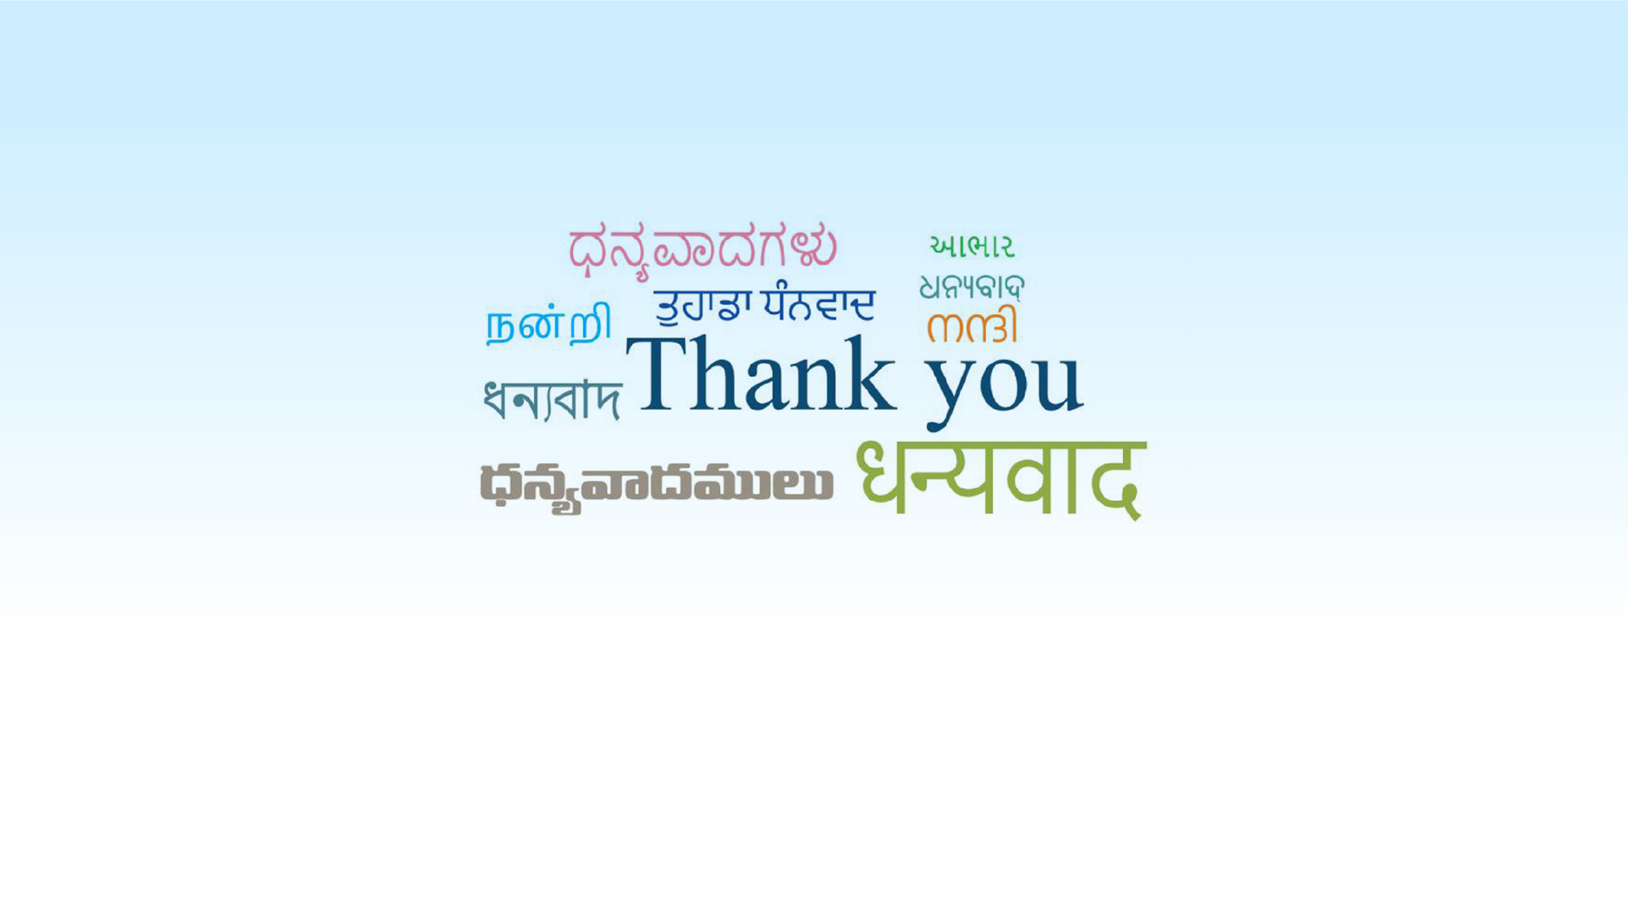
Innovating for a Multilingual Judiciary
Supported by

